Slide 1
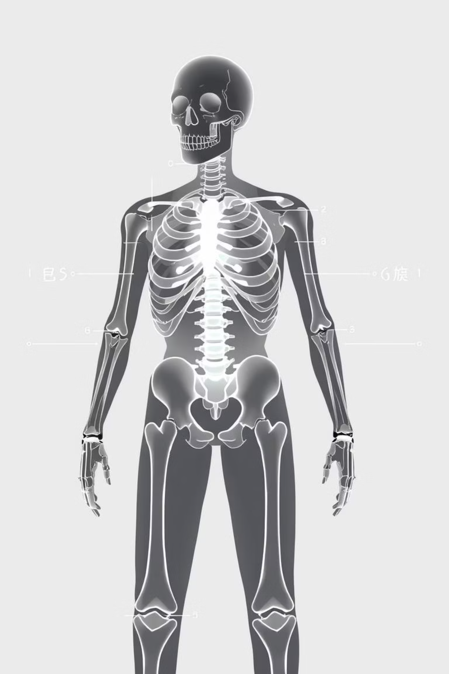
A real-time human bone fracture detection and classification
from multi-modal images using deep learning technique
Authors: Shahnaj Parvin, Abdur Rahman
Presented by
Yousha Rashid, Avoy Mollick, Nawshin Navin, Raiyen Zayed Rakin

Slide 2
Yousha Rashid
Introduction & Related Work (InceptionResNetV2)

Slide 3
Problem Statement & Motivation
• 206 bones in human body - frequent injuries from accidents, sports, falls
• Manual fracture detection is time-consuming and error-prone
• Radiologists face high workload and potential diagnostic delays
• Need for automated, accurate, real-time detection system
• Goal: Multi-class fracture classification from X-ray and MRI images

Slide 4
Types of Bone Fractures (10 Classes)
• Open Fracture - Bone pierces through skin
• Closed Fracture - Bone breaks but skin intact
• Displaced Fracture - Bone fragments misaligned
• Transverse Fracture - Horizontal break across bone
• Oblique Fracture - Diagonal break pattern
• Spiral Fracture - Twisting break around bone
• Comminuted Fracture - Bone shatters into multiple pieces
• Segmental Fracture - Two separate breaks in same bone
• Linear Fracture - Single straight-line crack
• Greenstick Fracture - Incomplete break in children's bones

Slide 5
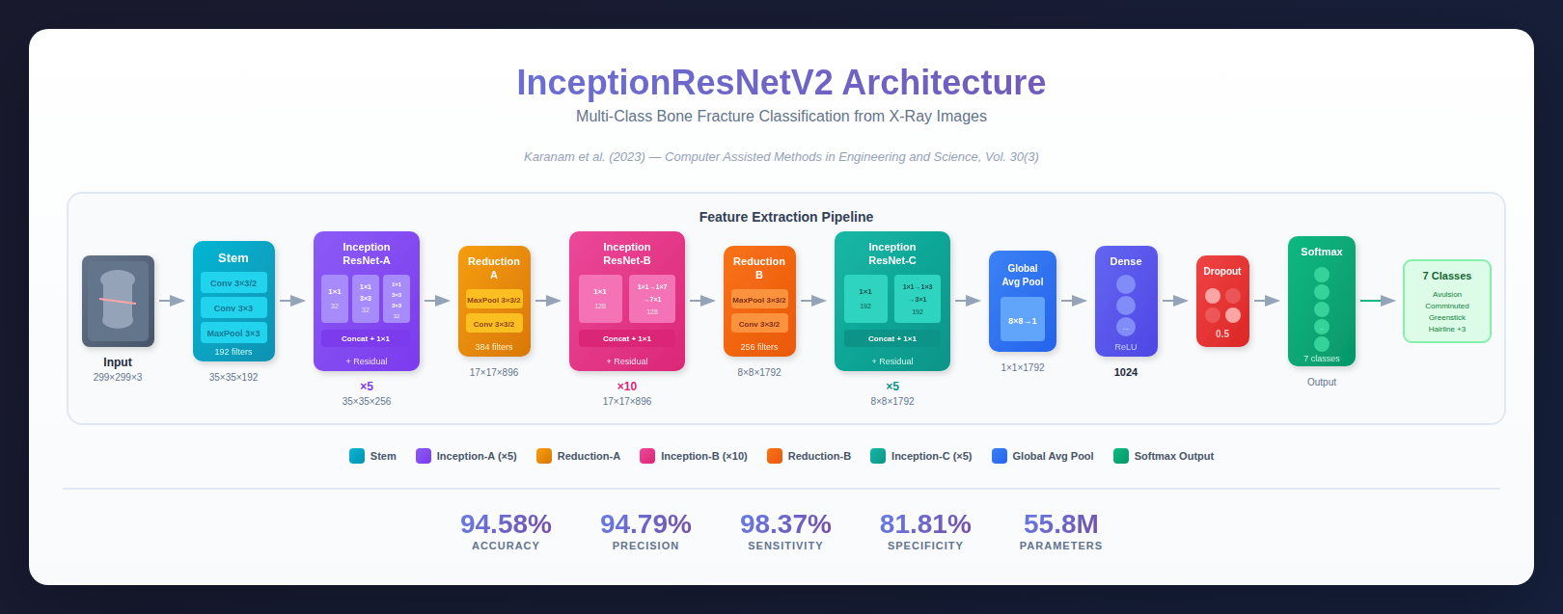
Related Work 1: InceptionResNetV2

Slide 6
Avoy Mollick
Two Related Works Architecture (CrackNet & SFNet)

Slide 7
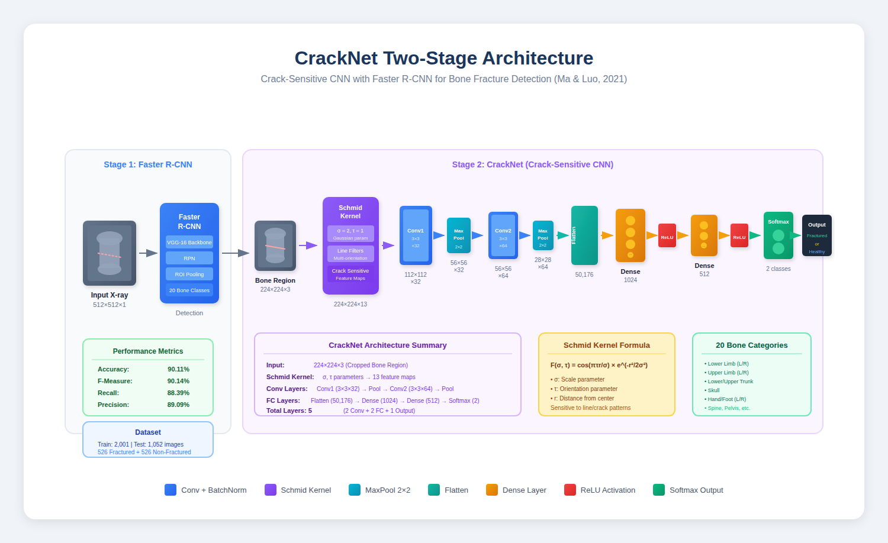
Related Work 2: CrackNet Two-Stage Architecture(Ma & Luo, 2021)

Slide 8
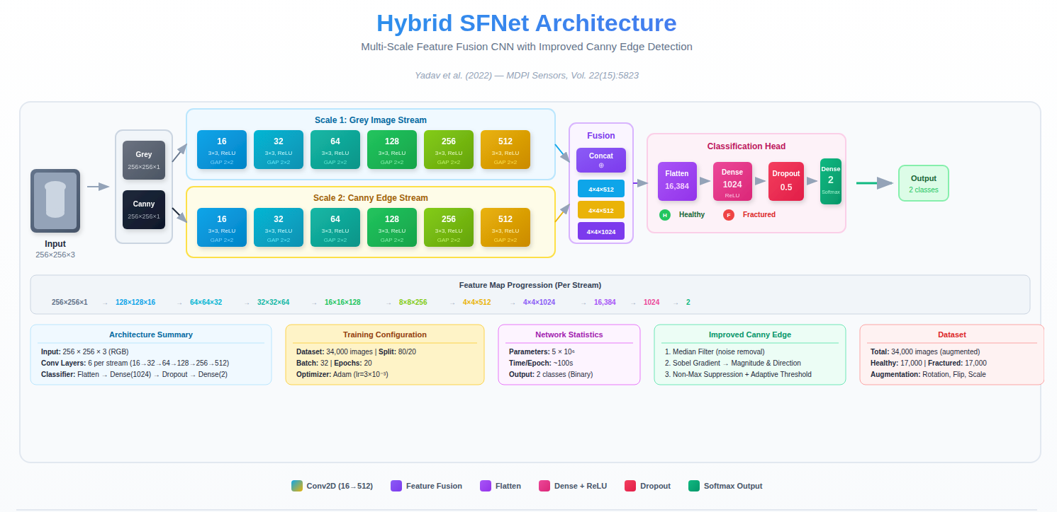
Related Work 3: SFNet + Canny Edge Detection (Yadav et al., 2022)

Slide 9
Nawshin Navin
YOLOv7 & Current Paper (YOLOv8)

Slide 10
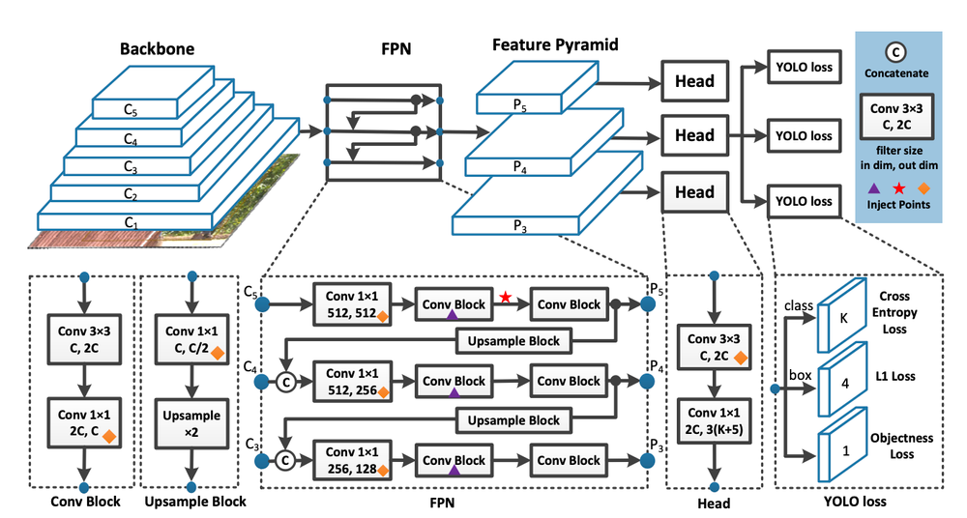
Related Work 4: YOLOv7

Slide 11
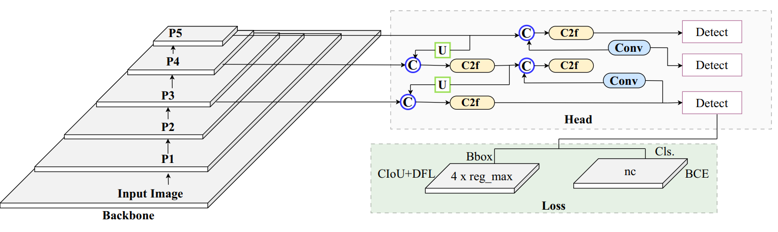
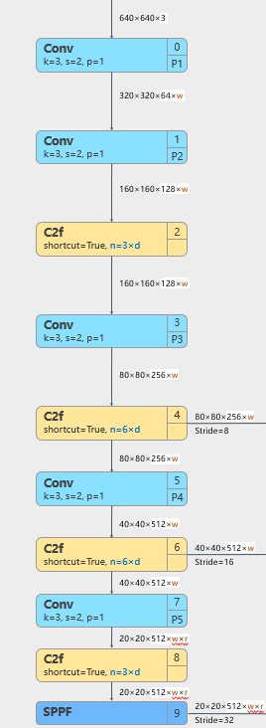
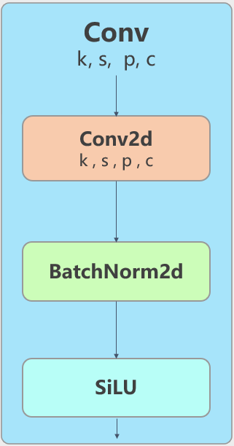
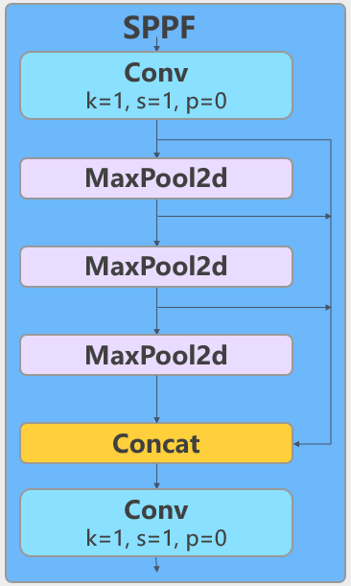
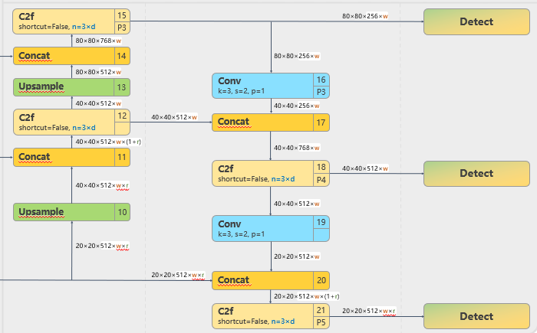
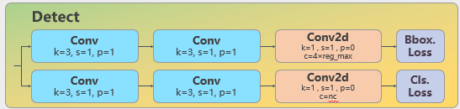
Current Paper: YOLOv8 Architecture
Backbone
Head

Slide 12
Raiyen Zayed Rakin
Proposed Improvements & Hypothesis

Slide 13
Current Paper Limitations
• Small dataset (641 images) - may limit generalization
• No attention mechanism - misses fine-grained fracture details
• Limited multi-scale feature fusion in neck architecture
• No fracture severity classification (mild/moderate/severe)
• Missing CT scan modality integration

Slide 14
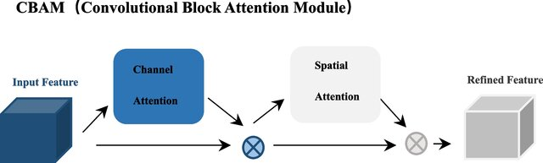
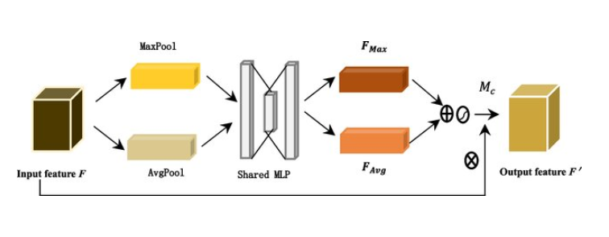
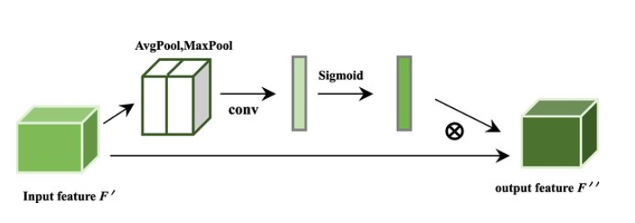
Proposed Architecture - Module
CBAM (Convolutional Block Attention Module)
Channel Attention
Spatial Attention
Notes:
Step 2: Shared MLP (Multi-Layer Perceptron)
Both pooled features go through the same neural network:
AvgPool output: 1×1×256 ──┐
├──→ MLP (Shared weights)
MaxPool output: 1×1×256 ──┘
Inside the MLP:
Input: 1×1×256
↓
Dense Layer 1: 1×1×256 → 1×1×(256/r) [r = reduction ratio, typically 16]
↓
ReLU activation
↓
Dense Layer 2: 1×1×(256/r) → 1×1×256 [back to original channels]
↓
Output: 1×1×256 (for each path)
What's happening? The network is learning: "Given the global statistics of each channel, how important is it for detecting fractures?"
Step 3: Element-wise Summation
AvgPool → MLP output: 1×1×256
+
MaxPool → MLP output: 1×1×256
↓
Combined: 1×1×256
That ⊕ symbol in your diagram! We're merging both perspectives.
Step 4: Sigmoid Activation
Combined: 1×1×256
↓
Sigmoid(x) = 1/(1+e^(-x))
↓
Channel Weights Mc: 1×1×256 [values between 0 and 1]
Example weights learned:
Channel 0 (fracture edge detector): Mc[0] = 0.94 ← Important!
Channel 1 (background noise): Mc[1] = 0.12 ← Not important
Channel 2 (bone density): Mc[2] = 0.87 ← Important!
Channel 3 (soft tissue): Mc[3] = 0.23 ← Less important
...
Channel 255: Mc[255] = 0.56 ← Moderate
Step 5: Channel-wise Multiplication (Recalibration)
Original Feature F: 80×80×256
×
Channel Weights Mc: 1×1×256 (broadcast to 80×80×256)
↓
Refined Feature F': 80×80×256
The ⊗ symbol - broadcasting multiplication!
What happens to each channel:
Channel 0: [80×80 pixel values] × 0.94 = [All values multiplied by 0.94] ⬆️ BOOSTED
Channel 1: [80×80 pixel values] × 0.12 = [All values multiplied by 0.12] ⬇️ SUPPRESSED
Channel 2: [80×80 pixel values] × 0.87 = [All values multiplied by 0.87] ⬆️ BOOSTED
...
Output: F' = 80×80×256 (channel-refined features)
PART 2: SPATIAL ATTENTION - "Where should we look?"
Now the channel-refined features F' enter the Spatial Attention module:
Step 6: Channel Pooling - Channel Compression
Input Feature F': 80×80×256
↓
Split into two operations
↓
Path A - AvgPool across channels:
80×80×256 → [Average across all 256 channels for each pixel]
↓
80×80×1 (one average value per spatial location)
Path B - MaxPool across channels:
80×80×256 → [Take maximum across all 256 channels for each pixel]
↓
80×80×1 (one max value per spatial location)
Think of it as: For each of the 6,400 pixels (80×80), we compute:
What's the average response across all 256 channels?
What's the maximum response across all 256 channels?
Step 7: Concatenation
AvgPool result: 80×80×1
‖ (concat along channel dimension)
MaxPool result: 80×80×1
↓
Combined: 80×80×2
That concat symbol in your diagram!
Step 8: Convolution Layer
Input: 80×80×2
↓
Conv2D: kernel=7×7, filters=1, padding=same
↓
Output: 80×80×1
What's happening? The 7×7 convolution looks at each pixel and its neighbors to decide: "Is this spatial location important for fracture detection?"
For example:
Pixels near fracture lines → high importance
Pixels in empty background → low importance
Pixels on bone edges → moderate importance
Step 9: Sigmoid Activation
Conv output: 80×80×1
↓
Sigmoid
↓
Spatial Weights Ms: 80×80×1 [values between 0 and 1]
Example spatial attention map:
Position (10, 15): Ms = 0.95 ← Fracture line here! PAY ATTENTION!
Position (20, 30): Ms = 0.08 ← Empty background, ignore
Position (45, 50): Ms = 0.72 ← Bone edge, somewhat important
Position (60, 70): Ms = 0.15 ← Soft tissue, less relevant
...
This creates a heatmap of importance!
Step 10: Spatial-wise Multiplication (Final Refinement)
Channel-refined Feature F': 80×80×256
×
Spatial Weights Ms: 80×80×1 (broadcast to 80×80×256)
↓
Final Output F'': 80×80×256
The final ⊗ symbol!
What happens:
At position (10, 15) - fracture line:
All 256 channels × 0.95 = STRONGLY ACTIVATED
At position (20, 30) - background:
All 256 channels × 0.08 = HEAVILY SUPPRESSED
At position (45, 50) - bone edge:
All 256 channels × 0.72 = MODERATELY ACTIVATED
Final Output: Refined Feature F''
Dimensions: Still 80×80×256
BUT NOW:
✓ Important channels are amplified (Channel Attention)
✓ Important spatial regions are highlighted (Spatial Attention)
✓ Fracture-relevant information is BOOSTED
✓ Background noise and irrelevant features are SUPPRESSED
The Complete Journey - Summary
Original Feature F (80×80×256)
↓
[CHANNEL ATTENTION]
• Squeeze spatial: 80×80×256 → 1×1×256
• Learn channel importance via MLP
• Get channel weights Mc (1×1×256)
• Multiply: F × Mc = F' (80×80×256)
↓
Channel-Refined F' (80×80×256)
↓
[SPATIAL ATTENTION]
• Squeeze channels: 80×80×256 → 80×80×2
• Learn spatial importance via Conv
• Get spatial weights Ms (80×80×1)
• Multiply: F' × Ms = F'' (80×80×256)
↓
Fully-Refined Output F'' (80×80×256)
For Your Presentation - The Narrative
"Let me walk you through the journey of a single feature map through CBAM.
We start with an 80×80×256 feature map extracted from a bone X-ray. First, it enters Channel Attention. Here, we ask: 'Which of these 256 channels actually matter for finding fractures?' We compress each channel down to a single number using both average and max pooling, creating two 1×1×256 vectors. These go through a shared neural network that learns channel importance, and after combining them with a sigmoid activation, we get 256 weights—one per channel. Channels detecting fracture lines might get 0.94, while noisy background channels get 0.12. We multiply the original features by these weights, amplifying important channels and suppressing noise.
The channel-refined features then flow into Spatial Attention. Now we ask: 'WHERE in this 80×80 grid should we focus?' We compress across channels using average and max pooling, creating two 80×80×1 maps showing overall activation at each location. These are concatenated and passed through a 7×7 convolution that learns spatial importance patterns. After sigmoid activation, we get an 80×80 attention map—a heatmap where fracture regions have values near 0.95 and empty background has values near 0.10. We multiply our channel-refined features by this spatial map.
The result? An 80×80×256 feature map that looks identical in size, but is fundamentally transformed—it now has laser focus on fracture-relevant information, with the right channels amplified and the right spatial regions highlighted. This is what makes CBAM so powerful for medical image analysis."
Would you like me to create a more visual, step-by-step diagram or animation script for this journey?
remake the 3 diagrams with all the labels
10:20 AM
CBAM Architecture Diagrams
Interactive artifact
I've created comprehensive interactive diagrams for CBAM with three tabs:
Features:
CBAM Overview Tab - Shows the complete flow from input feature through both attention modules to final output, with all dimension labels at each stage
Channel Attention Tab - Detailed step-by-step visualization showing:
Input splitting into AvgPool and MaxPool paths
Both paths going through Shared MLP
Element-wise summation (⊕)
Sigmoid activation producing channel weights
Final dimensions at each step (80×80×256 → 1×1×256 → final recalibration)
Spatial Attention Tab - Complete spatial attention flow showing:
Channel-wise pooling operations
Concatenation of pooled features
7×7 convolution layer
Sigmoid activation producing spatial weights
Dimension changes (80×80×256 → 80×80×2 → 80×80×1)
All diagrams include:
Exact dimension labels (80×80×256, 1×1×256, etc.)
Operation symbols (⊗ for multiply, ⊕ for sum, ‖ for concat)
Color-coded components for easy identification
Step-by-step flow with arrows
Detailed operation descriptions
A legend explaining all symbols
You can use these diagrams directly in your presentation or as a reference for creating slides!
why dont you make channel attention and spacial attention diagram like horizontally like the given like picture, keep the contents you have right now same. but labels is a must
10:30 AM
CBAM Architecture Diagrams
Interactive artifact ∙ Version 2

Slide 15
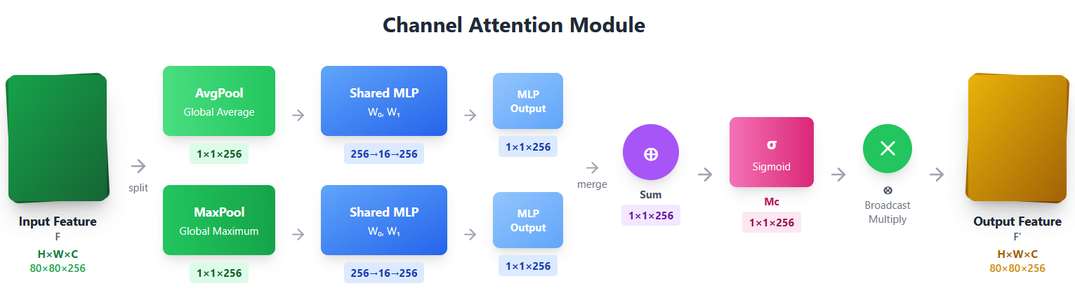

Slide 16
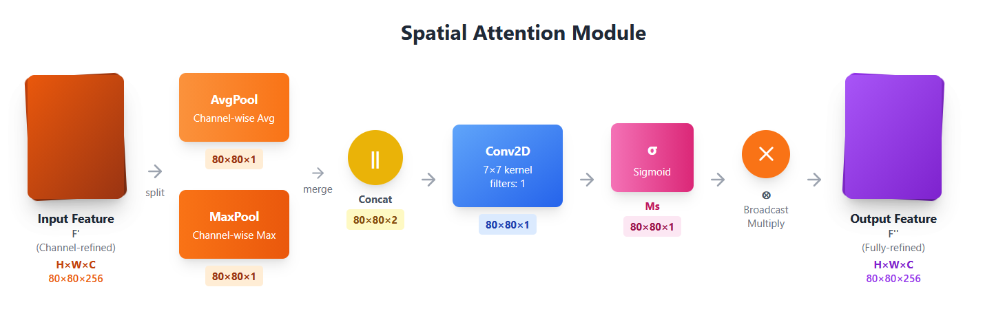

Slide 17
640×640×3
Proposed Architecture
Conv
k=3, s=2, p=1
0
P1
C2f
shortcut=False, n=3×d
320×320×64×w
15
Detect
Conv
k=3, s=2, p=1
P3
1
80×80×256×w
P2
80×80×768×w
14
CBAM
160×160×128×w
Concat
C2f
shortcut=True, n=3×d
2
80×80×512×w
80×80×256×w
13
Conv
k=3, s=2, p=1
160×160×128×w
Upsample
Conv
k=3, s=2, p=1
3
P3
40×40×256×w
17
40×40×512×w
Concat
80×80×256×w
CBAM
Backbone
C2f
shortcut=True, n=6×d
40×40×512×w
40×40×768×w
C2f
shortcut=False, n=3×d
18
Detect
Head
40×40×512×w
P4
C2f
shortcut=False, n=3×d
80×80×256×w
12
Conv
k=3, s=2, p=1
40×40×512×w
CBAM
40×40×512×w×(1+r)
40×40×512×w
11
C2f
shortcut=True, n=6×d
Concat
40×40×512×w
Conv
k=3, s=2, p=1
19
40×40×512×w
40×40×512×w×r
10
Conv
k=3, s=2, p=1
Upsample
7
20×20×512×w
P5
20×20×512×w×r
20
CBAM
Concat
20×20×512×w×r
20×20×512×w×r
C2f
shortcut=True, n=3×d
20×20×512×w×(1+r)
8
C2f
shortcut=False, n=3×d
20×20×512×w×r
21
Detect
20×20×512×w×r
P5
SPPF
9
80×80×256×w
Neck
20×20×512×w×r
Head

Slide 18
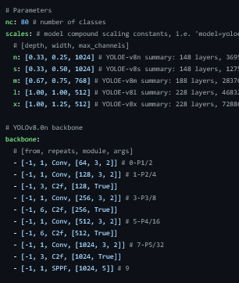
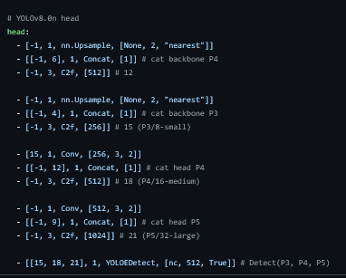
Proposed Architecture

Slide 19
Hypothesis & Expected Outcomes
Integrating CBAM attention mechanism with YOLOv8 and expanding the dataset will significantly improve detection accuracy, especially for challenging fracture types like Greenstick and Comminuted fractures.
Metric | Current | Expected
mAP50 | 92% | 96%
Precision | 95% | 97%
Recall | 93% | 95%
Greenstick | 68% | 85%
Comminuted | 82% | 92%

Slide 20
Conclusion & Summary
95%
92%
49.7MB
10
Precision
mAP50
Model Size
Classes
• YOLOv8 achieves state-of-the-art performance for bone fracture detection
• Multi-modal approach (X-ray + MRI) enhances diagnostic capability
• Compact model (49.7 MB) enables real-time clinical deployment
• Proposed CBAM integration expected to improve accuracy by 4%
• Future work: CT integration, severity grading, larger datasets

Slide 21
Thank You

